Slide 1
Department of Health and Human Services Budget Overview
Romaine Gilliland
DHHS Director
Presentation to the Human Services Network Agency Request Budget (A01)
October 21, 2014

Slide 2
DHHS’s Mission
The Department of Health and Human Services (DHHS) promotes the health and well-being of Nevadans through the delivery of essential services to ensure families are strengthened, public health is protected, and individuals achieve their highest level of self-sufficiency.
The department consists the following divisions: Aging and Disability Services, Child and Family Services, Health Care Financing and Policy, Public and Behavioral Health, Welfare and Supportive Services, and the Public Defender's Office.
Statutory Authority: NRS 232.290-465.
Helping People. It’s who we are and what we do.

Slide 3
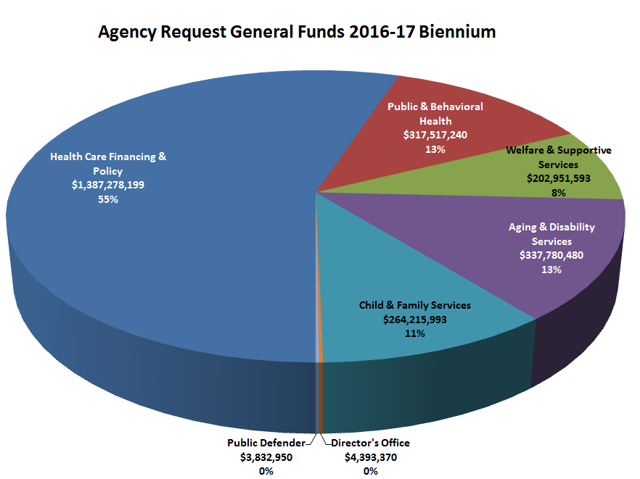
General Funds by Division, 2014-15 and 2016-17 Biennia
$2,043,980,148
$2,517,969,825

Slide 4
Revenues by Division, 2014-15 and 2016-17 Biennia
$7,413,368,829
$10,045,592,989

